Slide 1
RFP for Stripe
By Hakeem, Tanvir, Gabe, Ming, and Jaspreet

Slide 2
Building Proposal from Stripe
A company, Stripe, proposes that they want a headquarters at 101 Jefferson Avenue. They request that they want office space that are modern and allow for natural light to come.
They also request that the building be safe and have multiple entrances and that there will be rooms that are sound proof for productivity purposes and meetings.
They also request that there be parking area be available for the employees so that they won't have to look for parking in the vicinity.
Finally, they request the building to be safe and fire resistant as possible.

Slide 3
Proposal Plan
We the engineers of Leonce Architects & Engineers, LLC have taken into account the request that Stripe has proposed to use when building this building as well as added some extra suggestions to make the building a better working environment as well as a place where clients can be relaxed. We plan to engineer your building using a double glazed window system to bring an eco friendly material with a sleek cutting edge facade to present an aesthetically captivating building to the public.

Slide 4
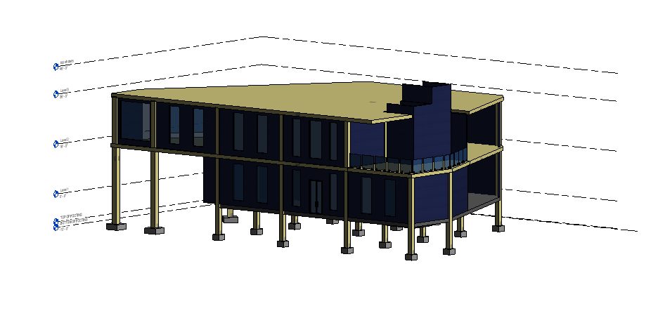
Proposal site

Slide 5
Project Site Scope
The previous slide showed the outside design of the building that shows some major features to the building. From the request, we have made it so that natural light can pass through the big window panels as well as allow show how modern the building looks from the outside. We also took into consideration the space as it can be seen, we have designed a building with a great amount of space for employes to be able to have a good atmosphere to have creative vibes. The structure’s skelton is steel encased in concrete to ensure fire resistance and structural safety for all your costly equipment and valuable workers.

Slide 6
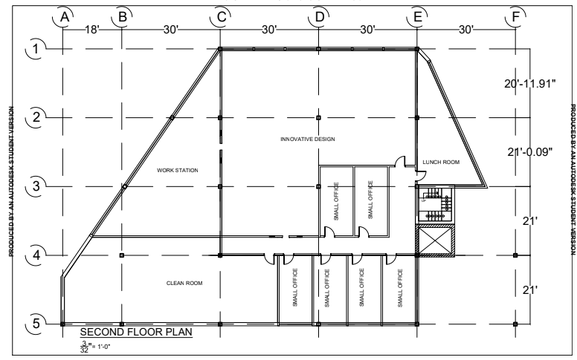

Slide 7
Second Floor Plan
This blueprint shows that open space that will allow for creative thinking among the employees as well as a very open area to have lunch and relax from all the days work with some scenery outside the big windows. There is also small office rooms employees can work in silence from distractions with soundproof walls.

Slide 8
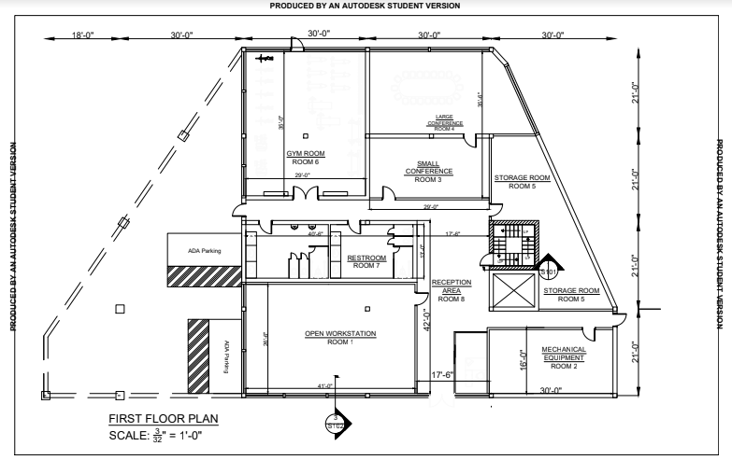

Slide 9
First Floor Plan
This first floor blueprint offers a large conference meeting room as well as smaller conference room for smaller meetings. As well a added bonus of a gym where the employees can go to workout after work to keep in shape. We also have accommodated for the fact that Stripe will need areas for storage so we have included rooms dedicated for storage. This blueprint also shows the parking area that was requested by Stripe. Restrooms are also located on the first floor.

Slide 10
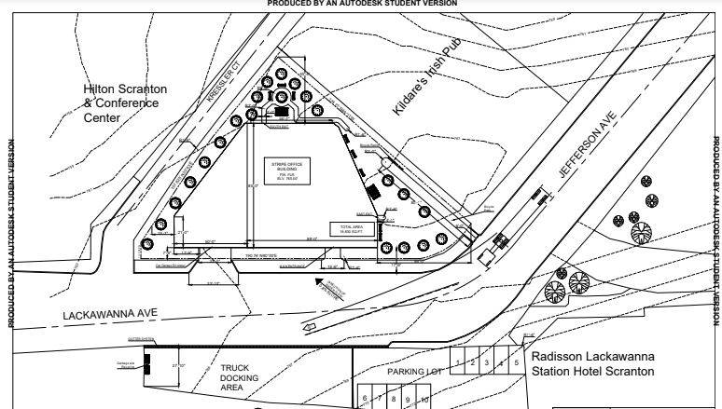

Slide 11
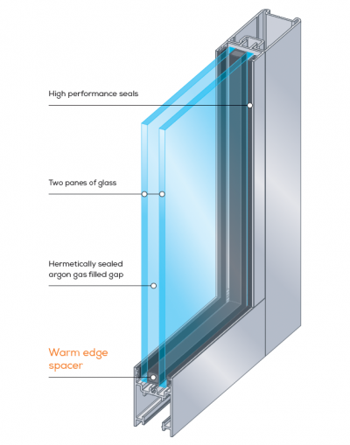
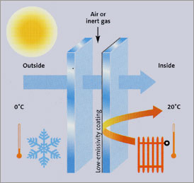

Slide 12
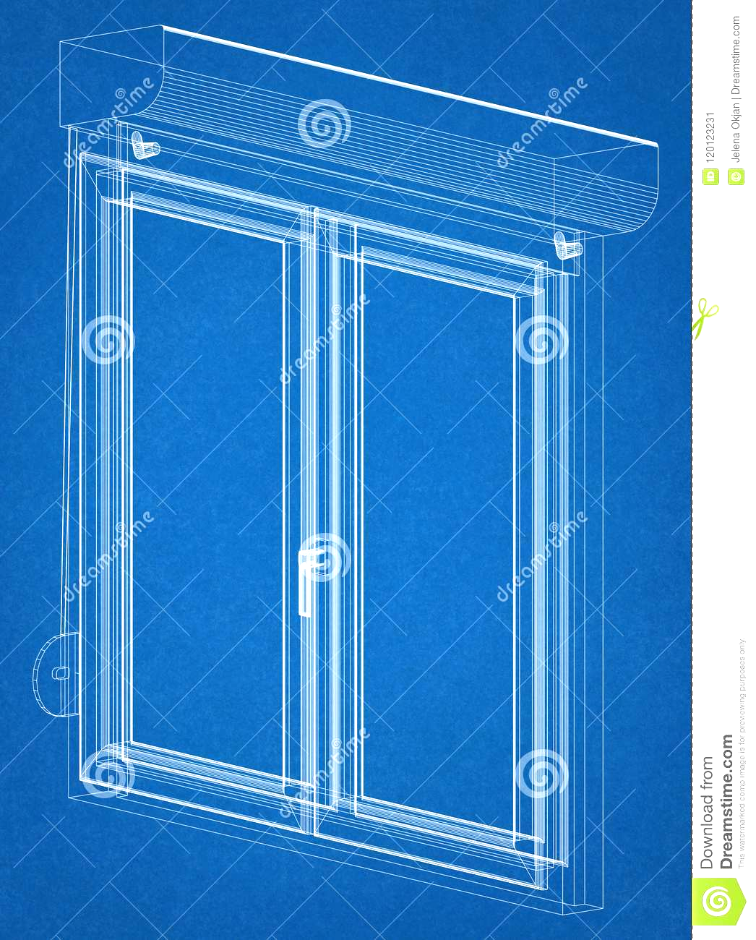
Double Glazed Windows and its Benefits
Double glazed windows are closed units made using two pieces of glass which are separated by an air gap of at least 12mm. The gap is sealed, and acts as a break between the inside and outside pieces of glass. The air gap is filled with gas which increases the insulation between the glass pieces. Double glazed windows are highly efficient, reducing your heat loss or gain by up to 30% when compared to single-glazed windows. Double glazing works much like woollen clothing and fibreglass batts. It traps air between the two layers. Glass is a good heat conductor, which means heat transfers straight through your windows without double glazing. On the other hand, air is a poor heat conductor, so the trapped air sets up insulating protection between cool air on one side and warm air on the other.

Slide 13
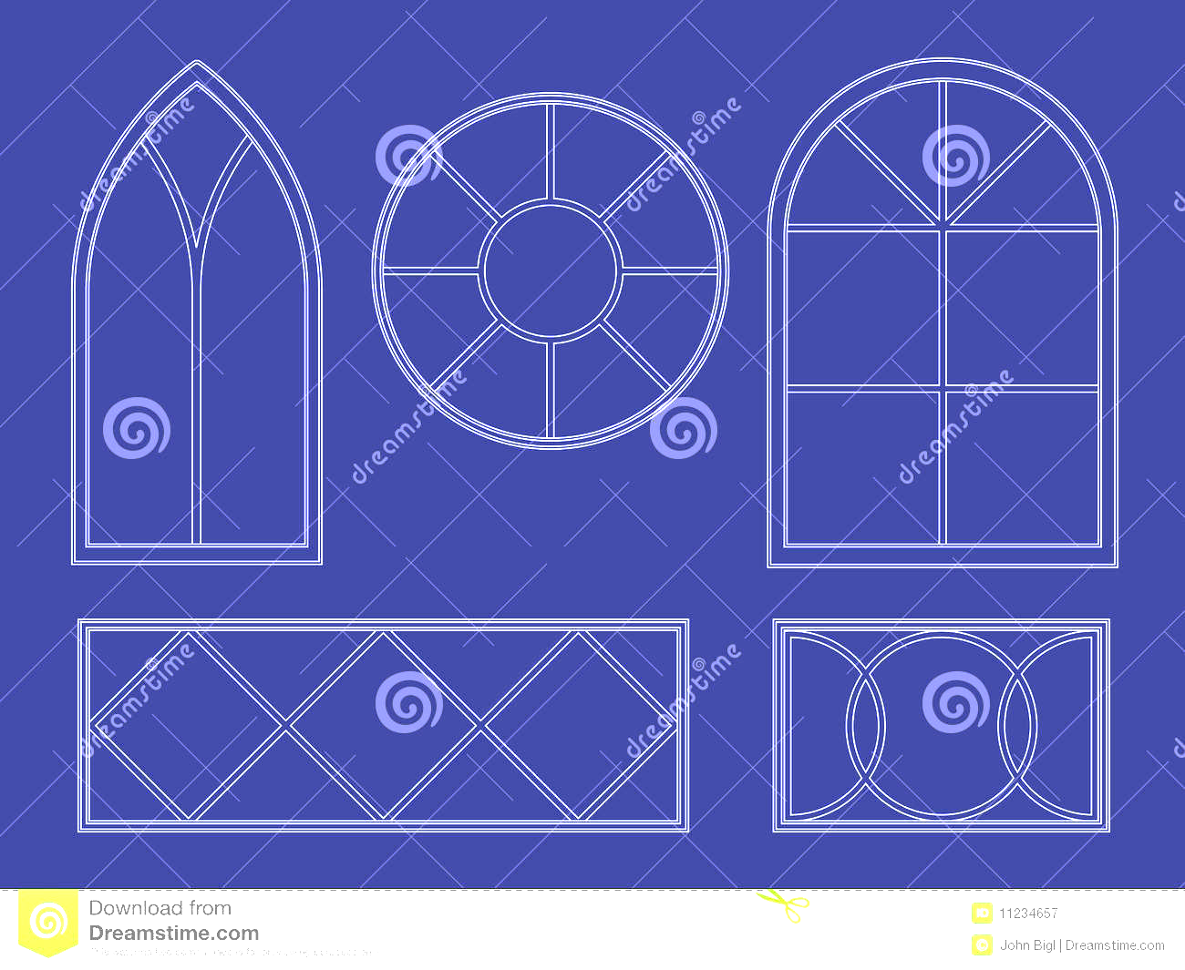
Project Allowance
Construction : $20.00 per square foot for approximately 11,600.00 sq ft
Stainless steel facade: $0.60 per pound
Double Glazed Windows : $265.00 per square foot for approximately 11,600.00 sq ft
Concrete : $1.60 per square foot for approximately 11,600.00 sq ft

Slide 14
Why Choose Leonce Architects & Engineers, LLC
Design and construct company
One project manager to directly carry out client’s program to design consultants and construction team
Check and balance system for all sides of the project team
Cut down on cost of finding separate contractor
Faster project completion date
Efficient movement

